Slide 1
File I/O & Threading
by
Dr. B. M. Mainul Hossain
Mar 27, 2016
mainul.raju@yahoo.com

Slide 2
Streams
A stream is a sequence of data. An I/O Stream represents an input source or an output destination.
A stream can represent many different kinds of sources and destinations, including disk files, devices, other programs, and memory arrays.
Streams support many different kinds of data, including simple bytes, primitive data types, localized characters, and objects.

Slide 3
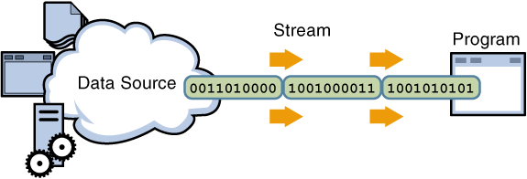
Input Streams
A program uses an input stream to read data from a source, one item at a time:

Slide 4
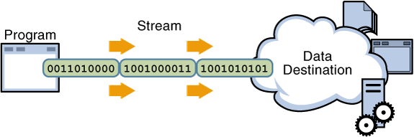
Output Streams
A program uses an input stream to read data from a source, one item at a time:

Slide 5
I/O Streams
Byte Streams: handle I/O of raw binary data.
Character Streams: handle I/O of character data, automatically handling translation to and from the local character set.
Buffered Streams: optimize input and output by reducing the number of calls to the native API
More Streams: Data Streams, Object Stream, etc.

Slide 6
Byte Streams
Programs use byte streams to perform input and output of 8-bit bytes.
All byte stream classes are descended from InputStream and OutputStream.
There are many byte stream classes. For file I/O, it is called FileInputStream and FileOutputStream.
Other kinds of byte streams are used in much the same way; they differ mainly in the way they are constructed.

Slide 7
Example Program: CopyBytes

Slide 8
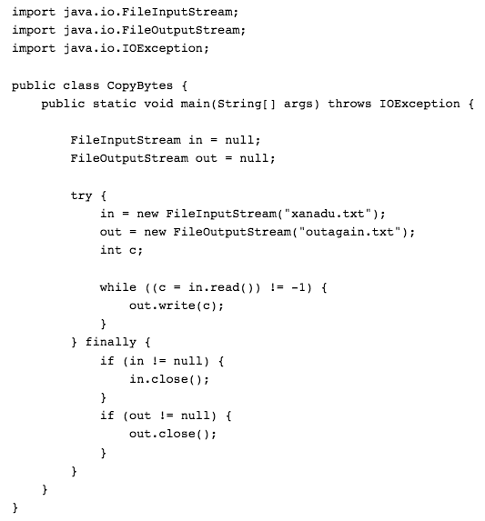

Slide 9
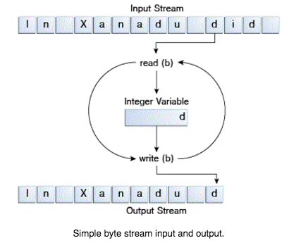

Slide 10

I/O Streams
Byte Streams: handle I/O of raw binary data.
Character Streams: handle I/O of character data, automatically handling translation to and from the local character set.
Buffered Streams: optimize input and output by reducing the number of calls to the native API.

Slide 11
Character Streams
A program that uses character streams in place of byte streams automatically adapts to the local character set
All character stream classes are descended from Reader and Writer.
As with byte streams, there are character stream classes that specialize in file I/O: FileReader and FileWriter.

Slide 12
Example Program: CopyCharacters

Slide 13
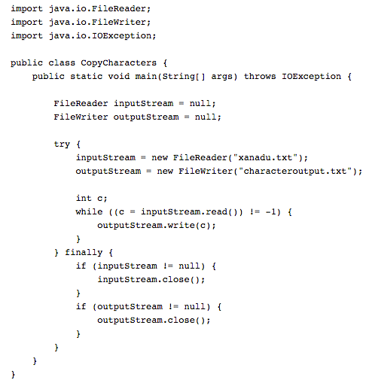

Slide 14
I/O Streams
Byte Streams: handle I/O of raw binary data.
Character Streams: handle I/O of character data, automatically handling translation to and from the local character set.
Buffered Streams: optimize input and output by reducing the number of calls to the native API.

Slide 15
Buffered Streams
The examples we've seen so far use unbuffered I/O. This means each read or write request is handled directly by the underlying OS. This can make a program much less efficient, since each such request often triggers disk access, network activity, or some other operation that is relatively expensive.
To reduce this kind of overhead, the Java platform implements buffered I/O streams. Buffered input streams read data from a memory area known as a buffer; the native input API is called only when the buffer is empty. Similarly, buffered output streams write data to a buffer, and the native output API is called only when the buffer is full.

Slide 16
Buffered Streams
A program can convert an unbuffered stream into a buffered stream using the wrapping idiom, where the unbuffered stream object is passed to the constructor for a buffered stream class.
CopyCharacters example to use buffered I/O:
inputStream = new BufferedReader(new FileReader("xanadu.txt"));
outputStream = new BufferedWriter(new FileWriter(“characteroutput.txt"));
Flushing Buffered Streams:
It often makes sense to write out a buffer at critical points, without waiting for it to fill. This is known as flushing the buffer. For example, PrintWriter object flushes the buffer on every invocation of println or format.

Slide 17
Line-Oriented I/O
Let's modify the CopyCharacters example to use line-oriented I/O.
Example Program: CopyLines

Slide 18
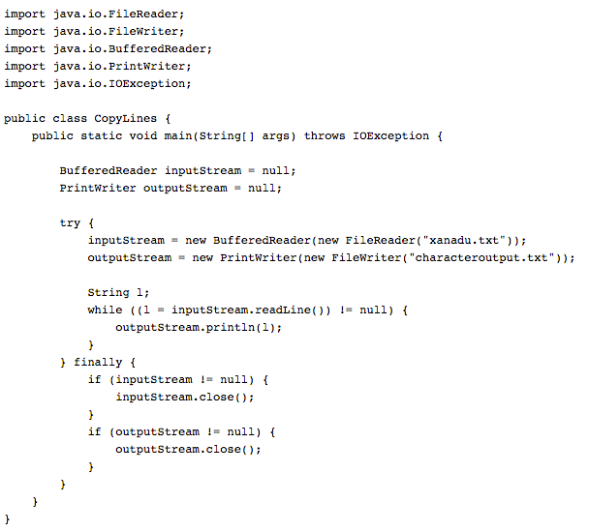

Slide 19
I/O Streams
Byte Streams: handle I/O of raw binary data.
Character Streams: handle I/O of character data, automatically handling translation to and from the local character set.
Buffered Streams: optimize input and output by reducing the number of calls to the native API.

Slide 20
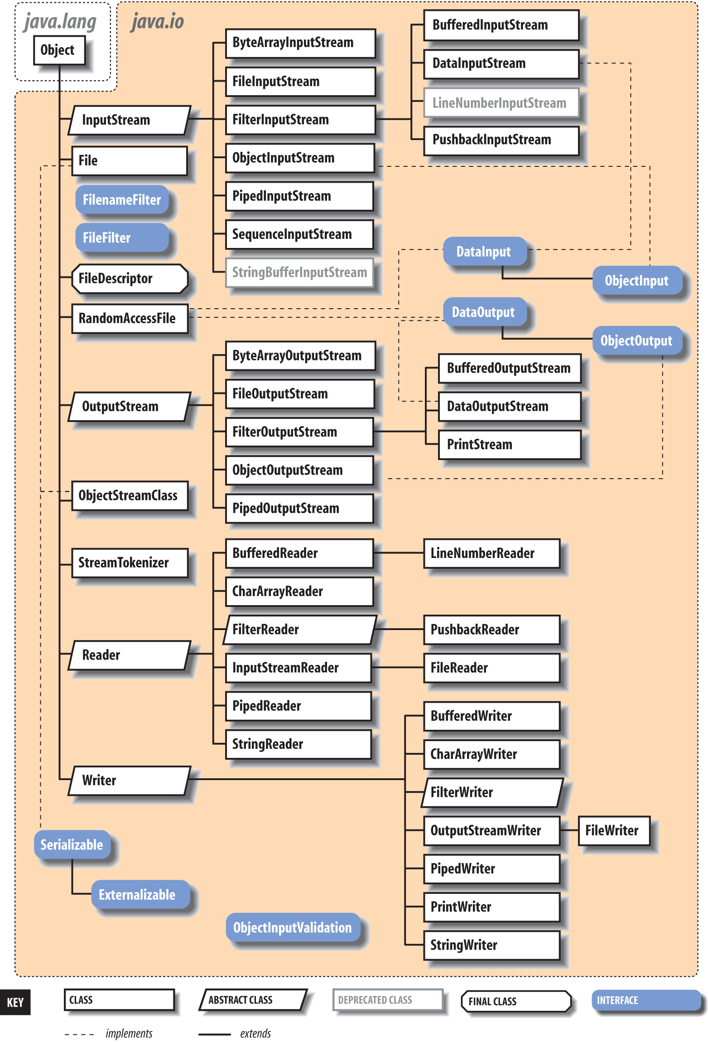

Slide 21
Threading
A thread is basically a smallest unit of processing.
Multithreading in java is a process of executing multiple threads simultaneously.
Multiprocessing and multithreading, both are used to achieve multitasking.

Slide 22
Multitasking
1) Process-based Multitasking (Multiprocessing)
Each process have its own address in memory.
Process is heavyweight.
Cost of communication between the process is high.
Switching from one process to another require some time for saving and loading registers, memory maps, updating lists etc.
2) Thread-based Multitasking (Multithreading)
Threads share the same address space.
Thread is lightweight.
Cost of communication between the thread is low.

Slide 23
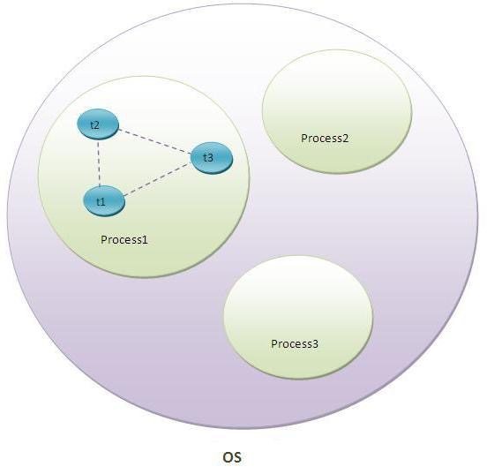
Threads

Slide 24
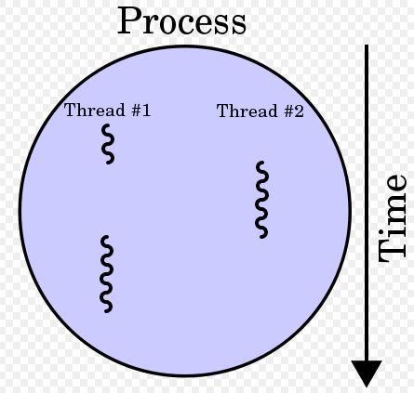
Threads

Slide 25
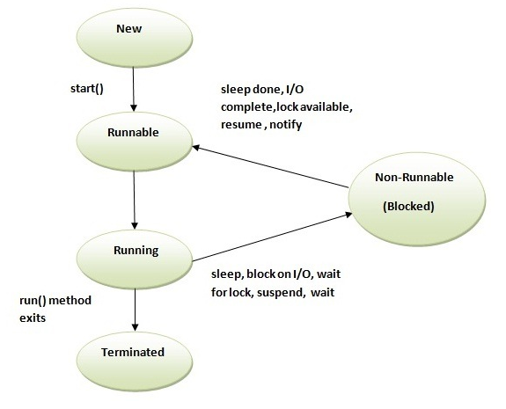
Threads

Slide 26
Thread Creation
There are two ways to create a thread:
By extending Thread class
By implementing Runnable interface.

Slide 27
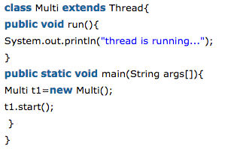
Thread By Extending

Slide 28
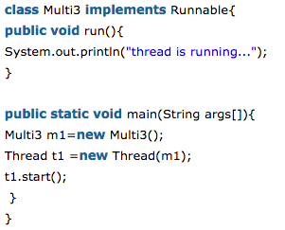
Thread By Implementing Interface

Slide 29
Methods of Thread Class
public void run(): is used to perform action for a thread.
public void start(): starts the execution of the thread. JVM calls the run() method
public void sleep(long miliseconds): Causes the currently executing thread to sleep
public void join(): waits for a thread to die.
public void join(long miliseconds): waits for a thread to die for the specified time.
public String getName(): returns the name of the thread.
public void setName(String name): changes the name of the thread.
public Thread currentThread(): returns the reference of currently executing thread.
public int getId(): returns the id of the thread.
etc…

Slide 30
Join Method
The join() method waits for a thread to die. In other words, it causes the currently running threads to stop executing until the thread it joins with completes its task.
Example Program

Slide 31
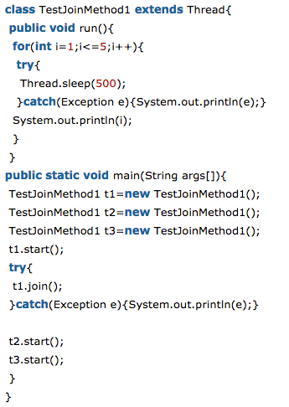
Join Method

Slide 32
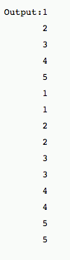
Join Method

Slide 33
Thank You

